Slide 1
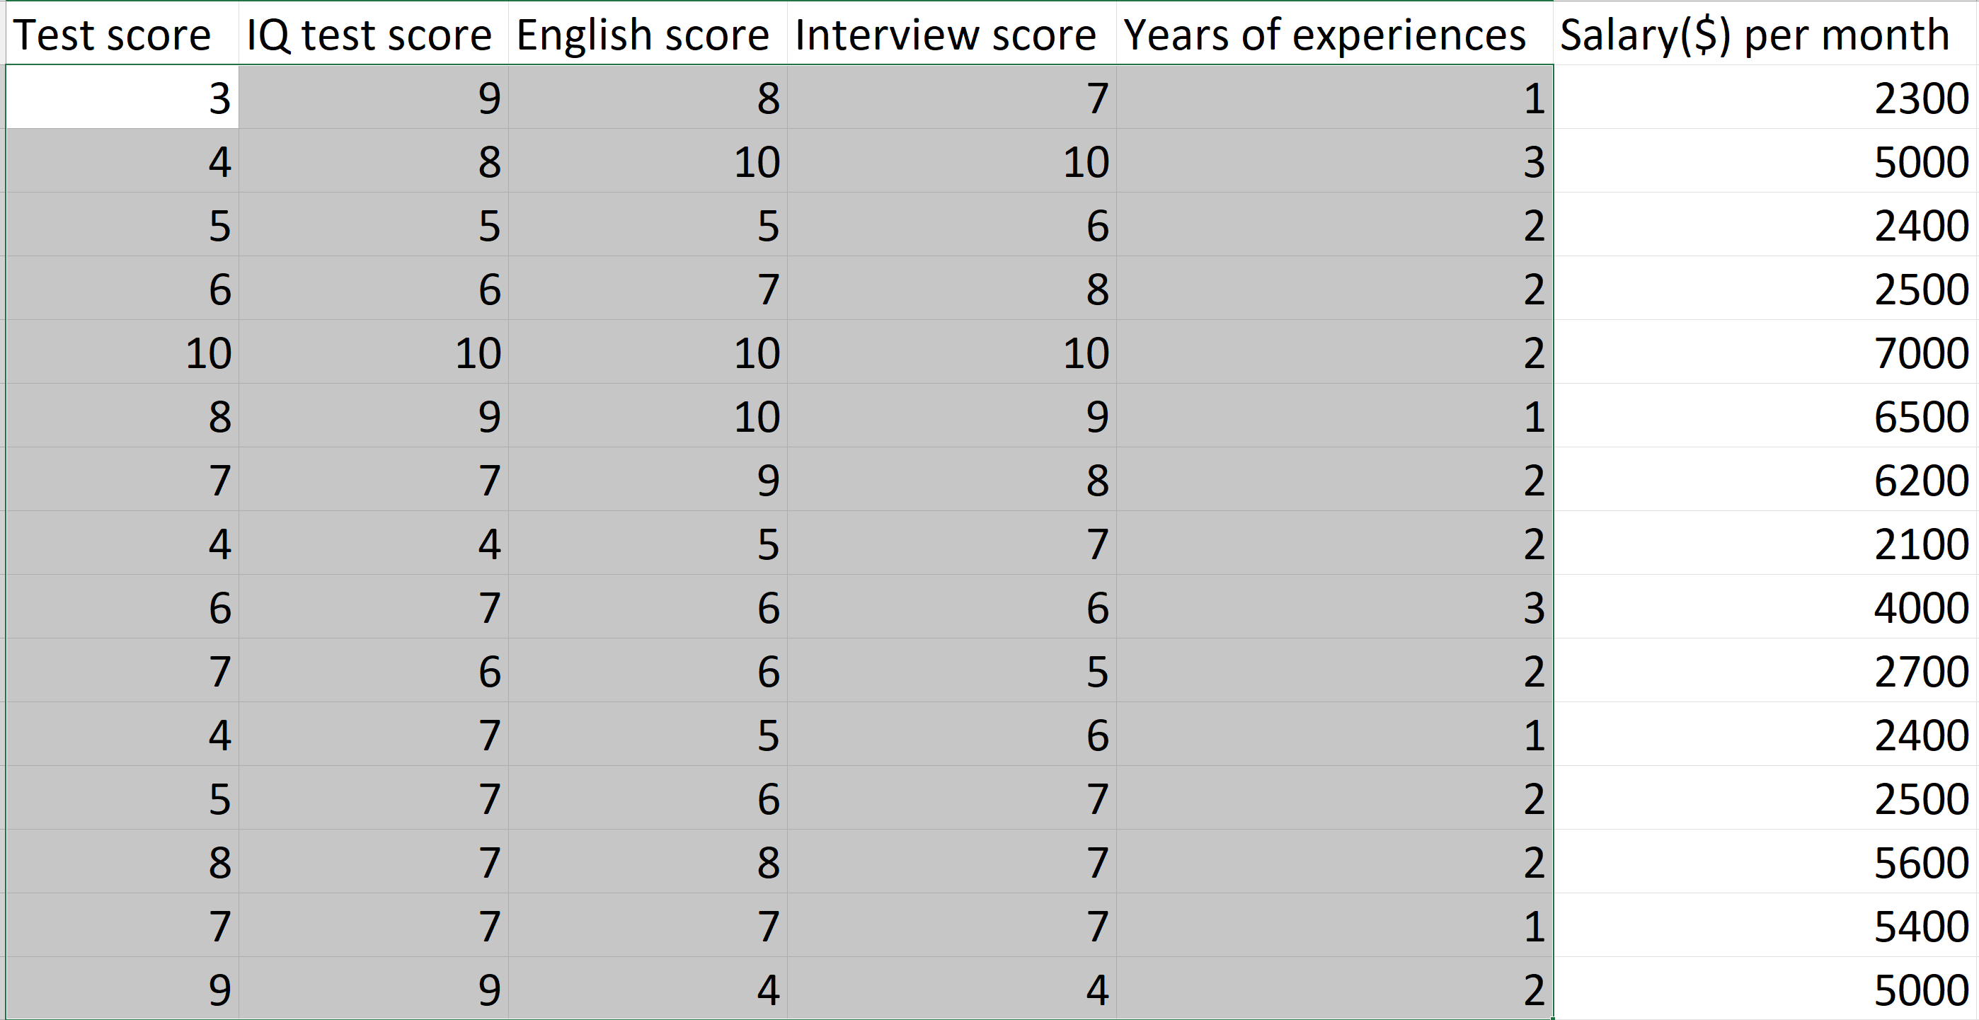
Model
Input
(features)
Output
(label)

Slide 2
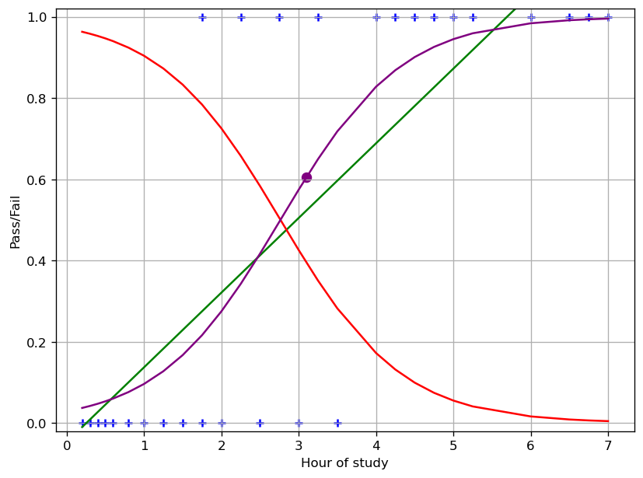
Hồi quy Logistic
1 biến

Slide 3
Sigmoid
y
1 / (1 + pow(e, -y))
e = 2.71828… = Euler constant

